Slide 1
Connecting LANs, Backbone Networks and Virtual LANs

Slide 2
Introduction
LANs do not normally operate in isolation.
They are connected to one another or to the Internet.
To connect LANs, or segments of LANs, the connecting devices are used.
Connecting devices can operate in different layers of the Internet model.

Slide 3
Connecting Devices
Connecting devices are distributed into five different categories based on the layer in which they operate in a network.

Slide 4
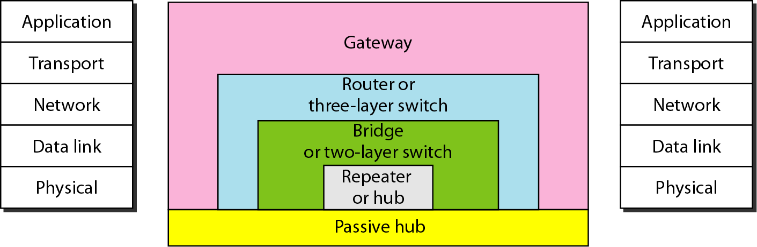
Connecting Devices and the 5-layer TCP/IP Internet Model
Those which operate below the physical layer, such as a passive hub.
Those which operate at the physical layer (a repeater or an active hub).
Those which operate at the physical and data link layers (a bridge or a two-layer switch).
Those which operate at the physical, data link, and network layers (a router or a three-layer switch).
Those which can operate at all five layers (a gateway).

Slide 5
Passive Hubs
A passive hub is just a connector. It connects the wires coming from different branches.
In a star-topology Ethernet LAN, a passive hub is just a point where the signals coming from different stations collide.
The hub is the collision point. This type of a hub is part of the media; its location in the Internet model is below the physical layer.
Notes:
Analog Signal is any continuous signal for which the time varying feature (variable) of the signal is a representation of some other time varying quantity.
A Digital Signal refers to an electrical signal that is converted into a pattern of bits.

Slide 6
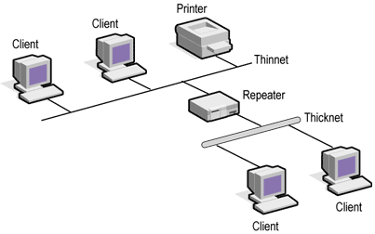
Repeaters
Repeater is a network device used to regenerate or replicate a signal. It operates at TCP/IP Layer 1 called as the Physical Layer.
Repeaters
Repeaters are used in the transmission systems to amplify analog signals and regenerate digital signals distorted by transmission loss.
Analog repeaters can only amplify the signal while digital repeaters can reconstruct a signal to near its original quality.
In a data network, a repeater can relay messages between networks that use different protocols or cable types.

Slide 7
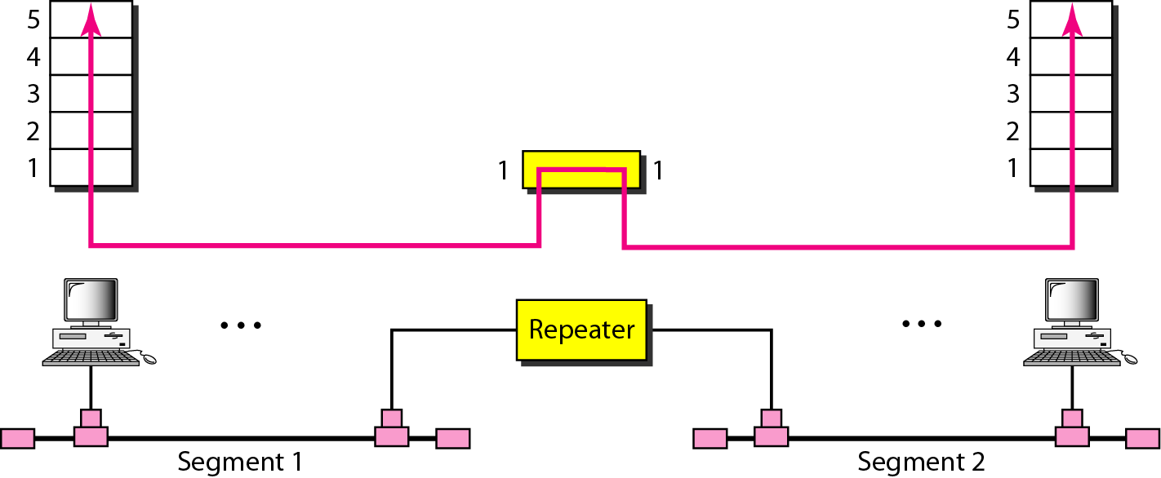
Repeaters
Repeaters
A repeater does not actually connect two LANs.
It connects two segments of the same LAN.
The segments connected are still part of one single LAN.
A repeater is not a device that can connect two LANs of different protocols.

Slide 8
Repeaters
The location of a repeater on a link is vital.
A repeater must be placed so that a signal reaches it before any noise changes the meaning of any of its bits.
A little noise can alter the precision of a bit's voltage without destroying its identity.
At junction point, the original voltage is not recoverable, and the error needs to be corrected.
A repeater placed on the line before the legibility of the signal becomes lost can still read the signal well enough to determine the intended voltages and replicate them in their original form.
Repeaters

Slide 9
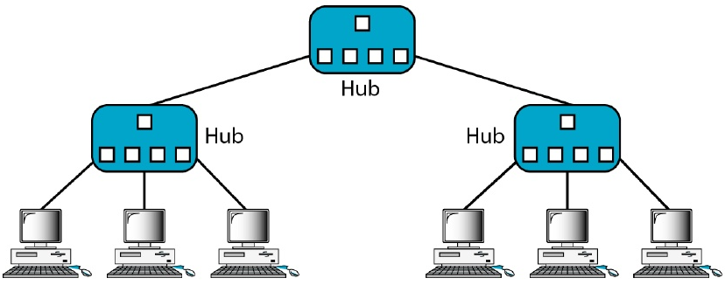
Hubs
Regenerate
or
Redirect
Hub is used in the centre of a star topology and this differs from the bus topology where having one cable fail will disrupt the entire network.
Hubs are classified into whether they are active or passive.
Most modern hubs are active; they take energy from a power supply to regenerate network signals.
Some hubs are called passive devices because they merely redirect the signals.
A hub is a repeater device that takes the data that comes into a port and sends it out all other ports in the hub (broadcast).
It is known as a multiport repeater and create a central connection point for the wiring media, and increase the reliability of the network.
The reliability of the network is increased by allowing any single cable to fail without disrupting the entire network.

Slide 10
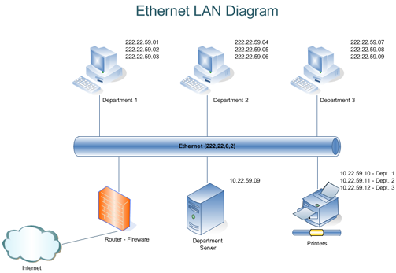
Ethernet LAN Segmentation
The primary reason for segmenting a LAN is to isolate traffic between segments and to achieve more bandwidth per user by creating smaller collision domains.
If two terminals are in the same collision domain then if both transmit at the same time their frames will collide.
The addition of devices such as bridges, switches and routers segment a LAN into multiple collision domains.
Segmenting a large network has numerous benefits. Among these are reduced collisions (in an Ethernet network) and the ability to filter out unwanted packets.
Note: Bandwidth is also defined as the amount of data that can be transmitted in a fixed amount of time.

Slide 11
Bridges
Bridges
Repeaters
Bridges were created to allow network administrators to segment their networks transparently.
It is up to the bridge to make sure that the frames get properly forwarded to their destinations.
This is the fundamental principle underlying all of the bridging behaviours.
Notes:
https://youtu.be/OBlJ3QuEt9k

Slide 12
Bridges
Bridges
Repeaters
A bridge operates in both the physical and the data link layer.
As a physical layer device, it regenerates the signal it receives.
As a data link layer device, the bridge can check the physical (MAC) addresses (source and destination) contained in the frame.
A bridge has a table used in the filtering decisions.
It can check the destination address of a frame and decide if the frame should be forwarded or dropped.
A bridge has a table that maps addresses to ports.
Notes:
https://www.tutorialspoint.com/uses-of-bridges-in-computer-network

Slide 13
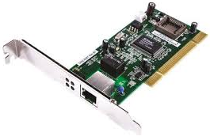
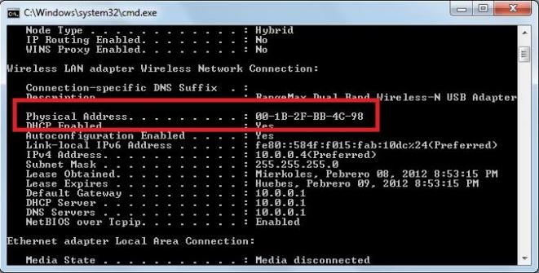
Network Interface Card (NIC)
A network interface card is a computer hardware component that connects a computer to a computer network.
The Network Interface Card (NIC) is also considered to be a Layer 2 device because it communicates using MAC addresses.
It uses its unique 48-bit MAC address to determine whether or not to accept a data frame by comparing its MAC address with the destination MAC address of the received frame.

Slide 14
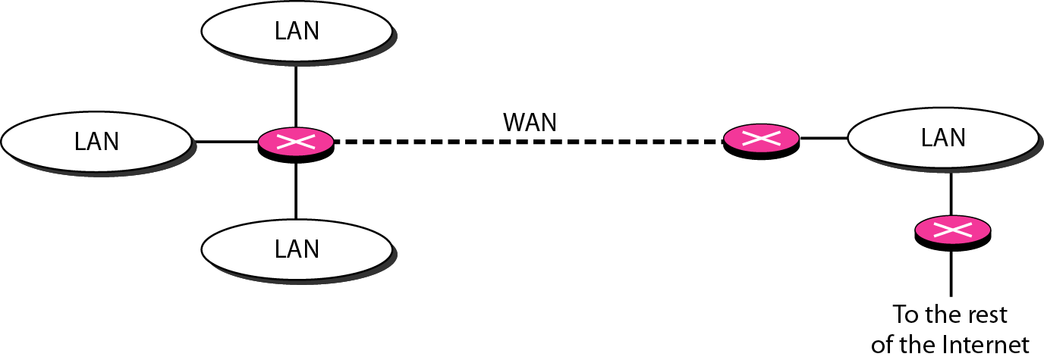
Routers
A router is a three-layer device that routes packets based on their logical addresses (host-to-host addressing).
Routers are TCP/IP model Layer 3 devices, and forward data depending on the Network address, not the Hardware (MAC) address.
For TCP/IP networks, this means the IP address of the network interface.
A router normally connects LANs and WANs in the Internet and has a routing table that is used for making decisions about the route based on the destination addresses in the header of the packets.
The routing tables are normally dynamic and are updated using routing protocols.
Routers
Bridges
Repeaters

Slide 15
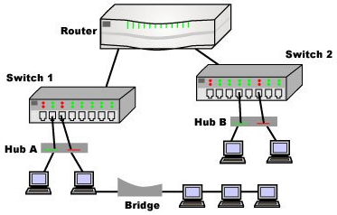
Layer 2 Switches
A switch is a Layer 2 device just as a bridge.
There are also layer 3 switches and layer 4 switches.
The difference between the hub and switch is that switches make decisions based on MAC addresses and hubs don't make decisions at all.
Routers
Bridges
Repeaters

Slide 16
Layer 2 Switches Versus Routers
Layer 2 Switches
Fast
Inexpensive
No benefits of alternative routing
Layer 3 Routers
Slow
Expensive
benefits of alternative routing
Routers
Bridges
Maxim
“Switch where you can; route where you must”
Repeaters

Slide 17
Early Site Networks
Organization
LANs (subnets) based on hubs
Routers link hubs
Hierarchy of Routers
Routers
Bridges
Repeaters
Router
Hub

Slide 18
The Switching Revolution
Switches Push Routers to the Edge
Switches replace most routers in site networks
Because switches are cheaper than routers
Routing’s sophistication is still needed at the edge
External
Router
Switch

Slide 19
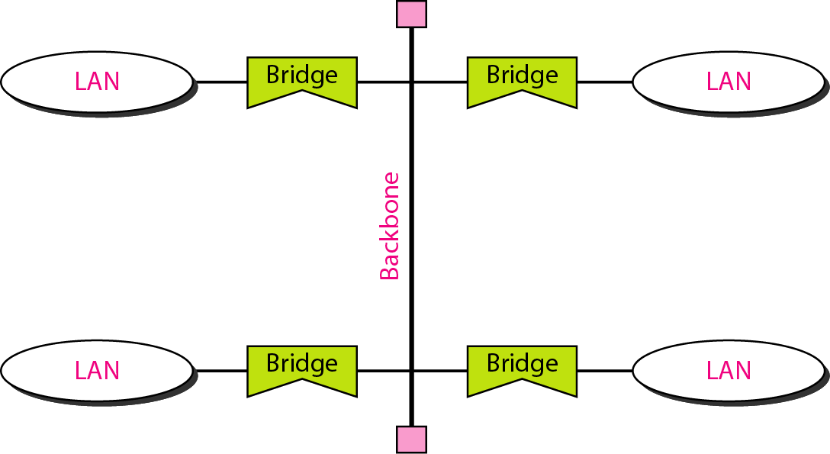
Bus Backbone
A bridge-based backbone with four LANs
A backbone network allows several LANs to be connected and the bus topology is used. The backbone itself can use one of the protocols that support a bus topology
A good example of a bus backbone is one that connects single- or multiple-floor buildings on a campus.
Multiple-floor buildings preferred to use a backbone (usually a star) that connects each LAN on a floor.
The bridge only allows to pass the frame to another LAN through backbone and blocks the frame of similar LAN.
Each bridge connected to the backbone has a table that shows the stations on the LAN side of the bridge.

Slide 20
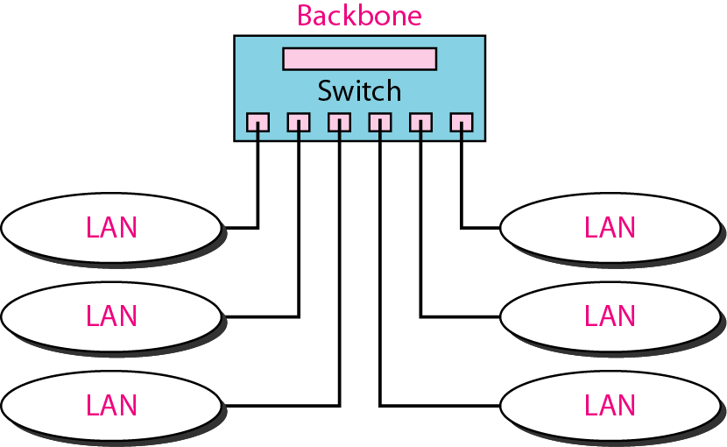
Star Backbone
Star Backbone
In this configuration, the switch does the job of the backbone and at the same time connects the LANs.
Star backbones are mostly used as a distribution backbone inside a building.
In a multi-floor building, we usually find one LAN that serves each particular floor. A star backbone connects these LANs.
The backbone network, which is just a switch, can be installed in the basement or the first floor, and separate cables can run from the switch to each LAN.
A rack or chassis in the basement where the backbone switch and all hubs or switches are installed.

Slide 22
Virtual LANs
The whole idea of Virtual LAN (VLAN) technology is to divide a LAN into logical, instead of physical segments.
Each VLAN is a workgroup in an organization. If a person moves workgroup there is no need to change physical connections.

Slide 23
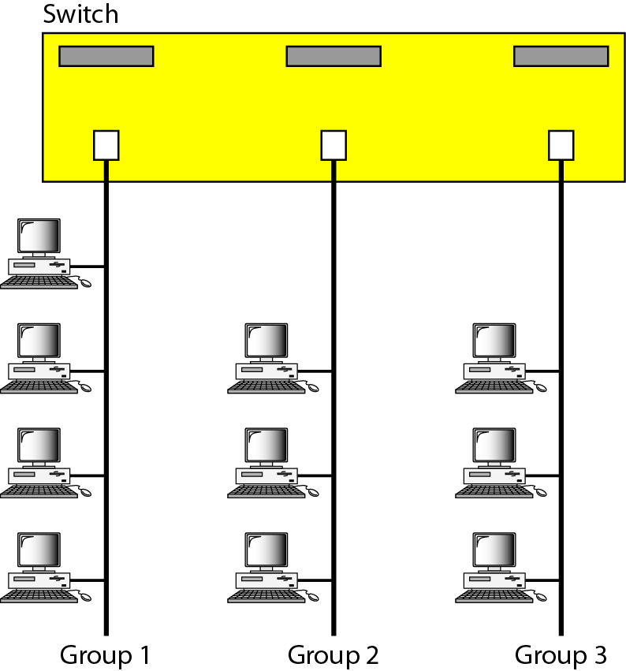
A Switch Connecting 3 LANs
Figure shows that 10 stations are grouped into three LANs that are connected by a switch.
The first four engineers work together as the first group, the next three engineers work together as the second group, and the last three engineers work together as the third group.
The LAN is configured to allow this arrangement.

Slide 24
A Switch Connecting 3 LANs
But what would happen if the administrators needed to move two engineers from the first group to the third group?
The network technician must rewire.
The problem is repeated if, in another week, the two engineers move back to their previous group.
In a switched LAN, changes in the work group mean physical changes in the network configuration.

Slide 25
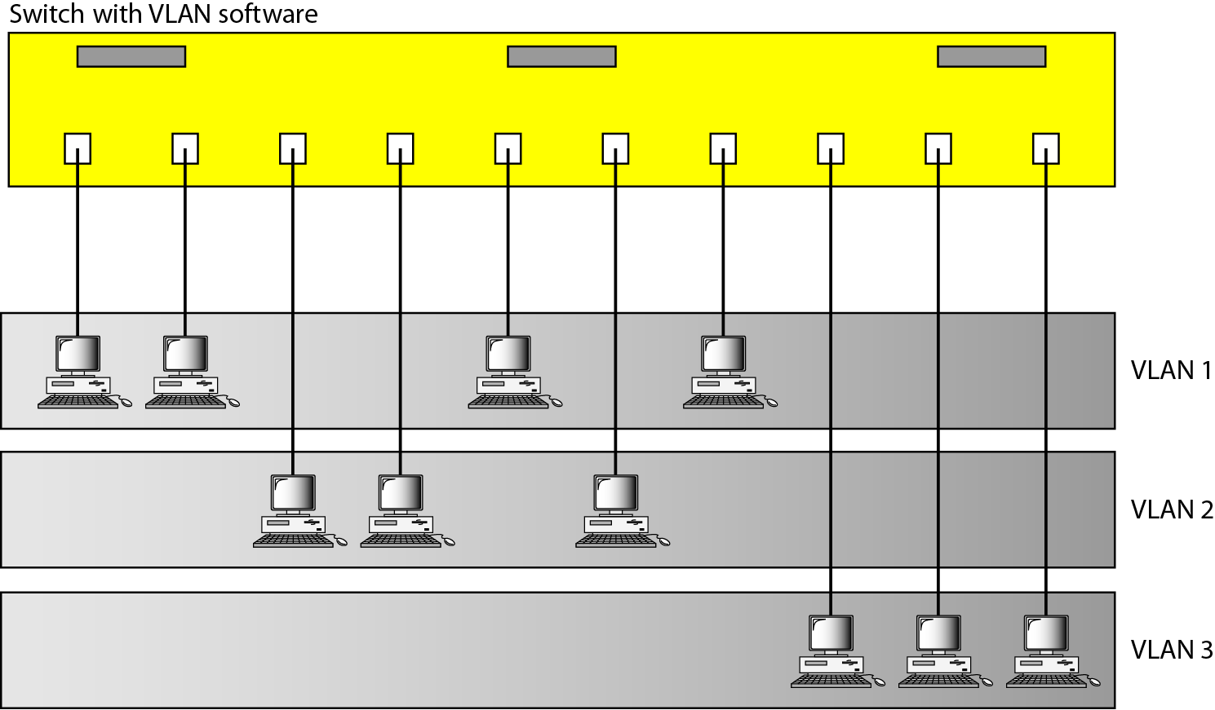
Virtual LANs
The idea of VLAN technology is to divide a LAN into logical, instead of physical segments.
A LAN can be divided into several logical LANs called VLANs. Each VLAN is a work group in the organization.
If a person moves from one group to another, there is no need to change the physical configuration.
The group membership in VLANs is defined by software, not hardware.
Any station can be logically moved to another VLAN.
All members belonging to a VLAN can receive broadcast messages sent to that particular VLAN.

Slide 26
Virtual LANs
VLAN technology even allows the grouping of stations connected to different switches in a VLAN.
Figure shows a backbone local area network with two switches and three VLANs.
Stations from switches A and B belong to each VLAN.
This is a good configuration for a company with two separate buildings.
Each building can have its own switched LAN connected by a backbone.
People in the first building and people in the second building can be in the same work group even though they are connected to different physical LANs.

Slide 27
VLAN Membership
What characteristics can be used to group stations in a VLAN?
Vendors use different characteristics such as:
Switch port numbers
MAC addresses
IP addresses
IP multicast addresses
Or a combination of two or more of the above

